Slide 1
OPTIMIZING SOLAR PANEL PLACEMENT A MACHINE LEARNING APPROACH TO MAPPING SOLAR ENERGY POTENTIAL
Group 3 (5 Feb 2024)
Ankit Mate - 230256765
Himanshu Sharma - 230369788
Parth Singh - 221150274
Ramsha Najam Kazi - 230230444
Vatsal Vipul Doshi - 230504415
MODULE: BUSM130 – GROUP PROJECT
Supervisor: Natalia Efremova, Meghna Asthana
Programme: Business Analytics MSc – 2023/24

Slide 2
Introduction – The Business Problem
Global Shift to Renewable Energy:
Growing focus on solar energy to cut greenhouse gas emissions.
Challenges in Solar Energy Generation:
Location and Weather: Solar potential is impacted by geography, weather patterns, and seasons.
Economic and Environmental Impact: Incorrect panel placement results in low energy yield, financial loss, and environmental consequences.
Need for Accurate Solar Mapping:
Why It Matters: Ensures optimal panel positioning, maximizes energy output, and boosts financial returns.
Technology Role: Leverages satellite data and weather information for accurate solar potential mapping.

Slide 3
Challenges and Broader Implications
Challenges in Developing Solar Energy Models:
Data Complexity
Model Accuracy
Potential Business Outcomes:
Resource Efficiency
Cost Reduction
Environmental Benefits
Broader Industry Implications:
Impact on Renewable Energy Sector

Slide 4
Literature Review
Introduction:
Importance of solar PV in global energy strategies
Challenges of integrating solar energy due to its intermittent nature
Need for accurate solar PV forecasting for grid stability
Geospatial Analysis for Solar PV Installation:
Use of NDVI, slope, and elevation data to identify optimal solar PV locations
NDVI helps filter out areas with dense vegetation (e.g., NDVI < 0.2)
Slope analysis using DEM data; ideal sites have slopes < 15 degrees
Elevation influences microclimates and solar irradiance
Machine Learning in Solar PV Forecasting:
Random Forest classifier for predicting site suitability
Advantages of Random Forest in handling large, complex datasets
Example: PVNet, a Long-Term Recurrent Convolutional Network, improves forecasting accuracy
Advanced Machine Learning Models:
Exploration of LSTMs and CNNs in PV forecasting
LSTMs for time-series forecasting and capturing long-range dependencies
CNNs process spatial data like satellite imagery
PVNet integrates NWPs and physical models for spatiotemporal accuracy

Slide 5
Literature Review
Integration of Satellite Data:
Importance of high-resolution satellite data in PV forecasting
Use of deep learning to interpolate and fuse satellite data
Improved temporal resolution of weather datasets
Case Studies and Real-World Applications:
Example: PVNet application in Germany improving solar PV forecasting accuracy
Impact on energy markets, improving day-ahead forecasts
Example: Temporal interpolation of satellite data for enhanced forecasts
Challenges and Future Directions:
Need for high-quality data for training ML models
Interpretability of complex ML models as a barrier to adoption
Better integration of forecasting models with grid management systems
Future research directions: satellite data integration, interpretable models
Emphasis on the potential of advanced ML models to improve forecasting accuracy
Future challenges and the need for continued research

Slide 6
Weather Data Analysis for Solar Panel Installation
Dataset Overview
Total Rows: 25,043
Temperature: Average maximum is 12.69°C, while the average minimum is 5.87°C.
Rainfall and Sunshine: Average rainfall is 74.67 mm, with an average of 116.4 sunshine hours per month.
Air Frost Days: Average of 3.38 days per month.
Data Coverage: Spans 167 years across all 12 months.
Feature | Range | Mean/Average
Year | 1853 to 2020 | 1967
Month | 1 to 12 | 6.49 (June)
Max Temperature (tmax) | -0.7°C to 28.3°C | 12.69°C
Min Temperature (tmin) | -8.6°C to 17.0°C | 5.87°C
Air Frost Days (af) | 0 to 31 days | 3.38 days
Rainfall | 0 mm to 568.8 mm | 74.67 mm
Sunshine (Sun) | 4 to 350 hours | 116.4 hours
Latitude | 50.22° to 60.13° | -
Longitude | -6.86° to 1.75° | -
Notes:
Dataset Overview:
Covers 167 years (1853-2020) with monthly data.
Key features: maximum and minimum temperature, air frost days, rainfall, sunshine hours, latitude, and longitude.
Average values: Max temperature ~12.69°C, Min temperature ~5.87°C, Rainfall ~74.67 mm, Sunshine ~116.4 hours.
Insights:
Important for understanding regional climate patterns to optimize solar panel placement.

Slide 7
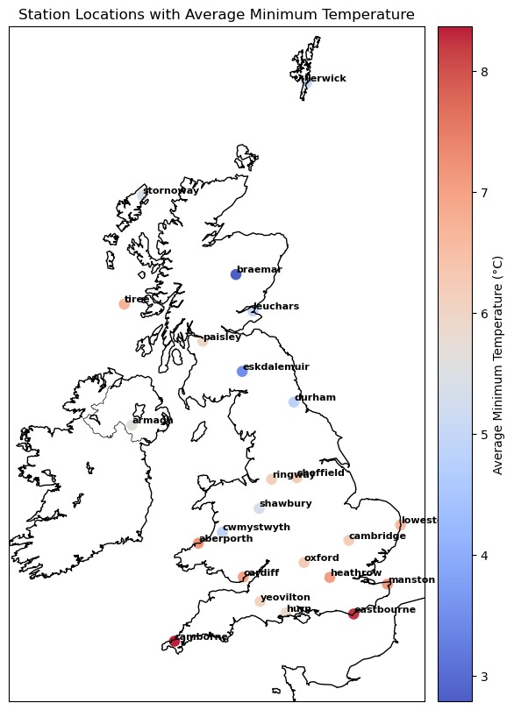
Average Minimum Temperature
Distribution Across the UK
Geographical Spread:
Coverage: From northern Scotland to southern England, including Northern Ireland and Wales.
Temperature Distribution:
Northern Regions(Scotland): Stations like Lerwick, Stornoway, Tiree, and Braemar are shaded in blue/light blue, indicating cooler average maximum temperatures.
Regional Patterns:
Scotland/Northern Ireland: Cooler, with blue hues.
Wales: Moderate temperatures.
England: Warmer in the south, with highest temperatures in the southeast.
Notes:
Geographical Coverage:
From Northern Scotland to Southern England, including Northern Ireland and Wales.
Temperature Patterns:
Cooler temperatures (blue/light blue) in Northern Scotland (e.g., Lerwick, Stornoway).
Moderate temperatures in Wales; warmer temperatures in Southern England.
Highlights areas with potentially less solar irradiance due to lower temperatures.

Slide 8
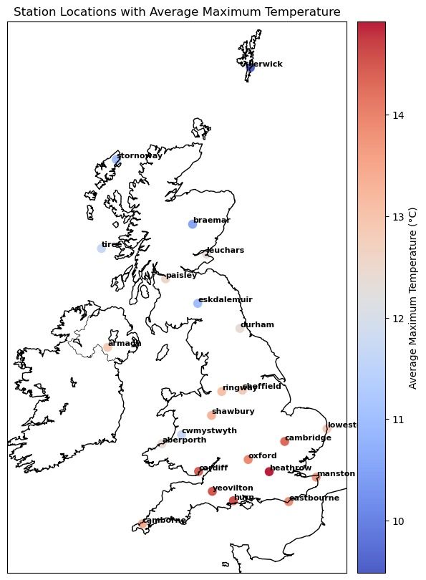
Average Maximum Temperature
Distribution Across the UK
Geographical Spread:
Coverage: From northern Scotland to southern England, including Northern Ireland and Wales.
Temperature Distribution:
Central and Southern Regions: Stations such as Heathrow, Oxford, and Cambridge appear in red/orange, reflecting warmer temperatures, particularly concentrated in the southeastern regions.
Regional Patterns:
Scotland/Northern Ireland: Cooler, with blue hues.
Wales: Moderate temperatures.
England: Warmer in the south, with highest temperatures in the southeast.
Notes:
Geographical Coverage:
Similar to the previous slide, covering the whole UK.
Temperature Patterns:
Warmer regions (red/orange) in Central and Southern England (e.g., Heathrow, Oxford, Cambridge).
Cooler temperatures in Scotland and Northern Ireland (blue hues).
Indicates regions where higher temperatures might favor solar panel efficiency.

Slide 9
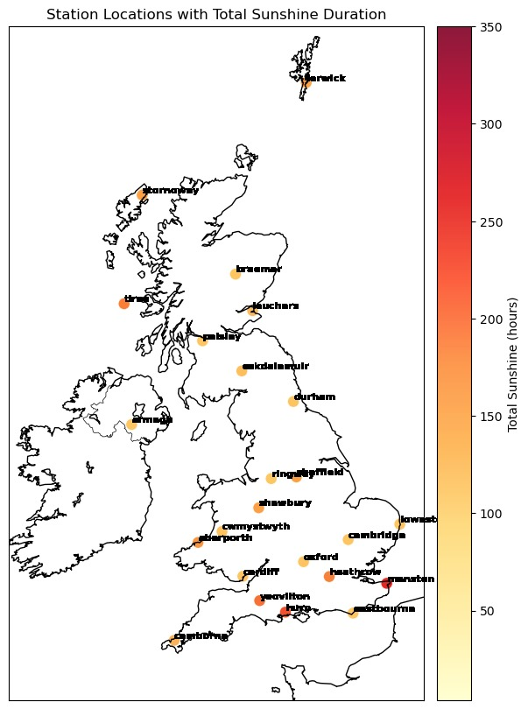
Total Sunshine Duration
Across the UK
Sunshine Gradients:
Deep Red: Higher sunshine hours (e.g., Lerwick, Manston).
Light Yellow: Fewer sunshine hours (e.g., Camborne, western Scotland).
Coastal vs. Inland Trends:
Coastal Regions: Higher sunshine durations (e.g., Eastbourne, Manston) due to fewer obstacles and moderating sea influence.
Inland Regions: Lower sunshine durations (e.g., Eskdale Muir, Shawbury) reflecting cloudier, wetter conditions.
Cambridge Highlight:
Sunnier Area:
150-200 hours of sunshine (based on colour coding).
Positioned southeast, benefiting from more sunshine compared to northern or western regions.

Slide 10
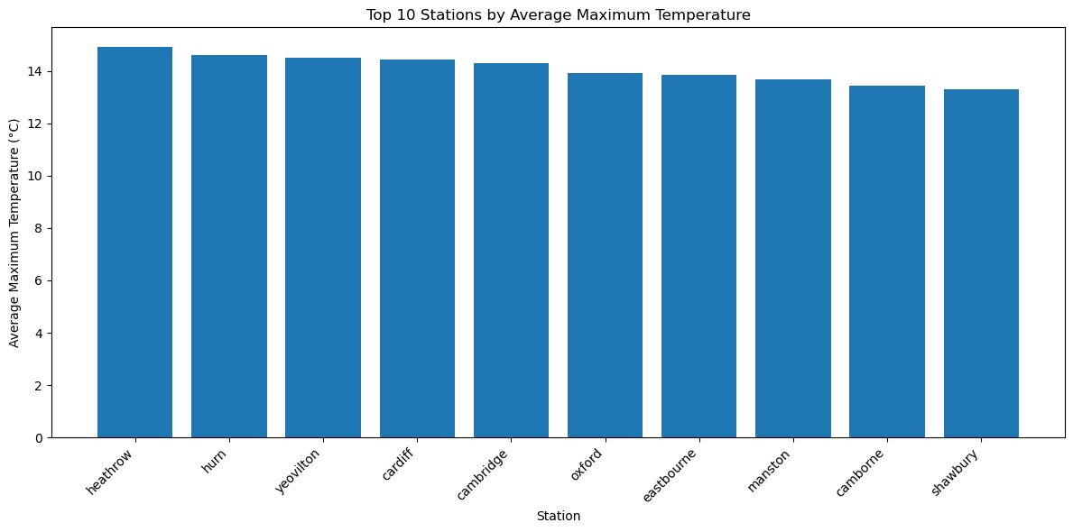
Top 10 Stations by Average Maximum Temperature
Top Station:
Heathrow: Highest average maximum
temperature, slightly above 14°C.
Other Notable Stations:
Hurn, Yeovilton, Cardiff: Average
maximum temperatures just over
14°C.
Lowest Station in Top 10:
Shawbury: The station with the
lowest average maximum temperature
among the top 10.

Slide 11
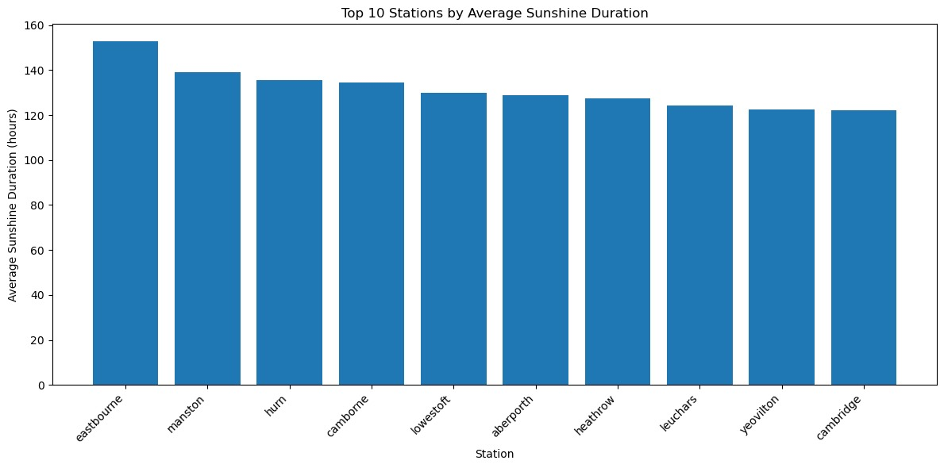
Top 10 Stations by Average Sunshine Duration
Top Station:
Eastbourne: Highest average
sunshine duration, 160 hours.
Other High Sunshine Stations:
Manston: Nearly 150 hours.
Hurn, Camborne, Lowestoft:
Between 140-145 hours.
Remaining Stations:
Aberporth, Heathrow, Leuchars,
Yeovilton, Cambridge: Between 135-140 hours.
Cambridge Analysis:
Sunshine Duration: Relatively high, suitable for solar panel installations.
Climate: Mild temperatures year-round enhance solar panel efficiency.
Land Availability: Mix of urban, residential, and rural areas offers diverse opportunities for installations.

Slide 12
Sentinel-2 Spectral Bands
Sentinel-2 Spectral Bands
Blue Band (B02)
Red Band (B04)
Near-Infrared Band (B08)
Short-Wave Infrared Band (B11)
Green Band (B03)
Blue Band (B02): Coastal and water body monitoring
Green Band (B03): Vegetation analysis and plant health
Red Band (B04): Vegetation analysis, NDVI calculation
Near-Infrared Band (B08): Vegetation health and land cover
Short-Wave Infrared Band (B11): Moisture content, urban areas

Slide 13
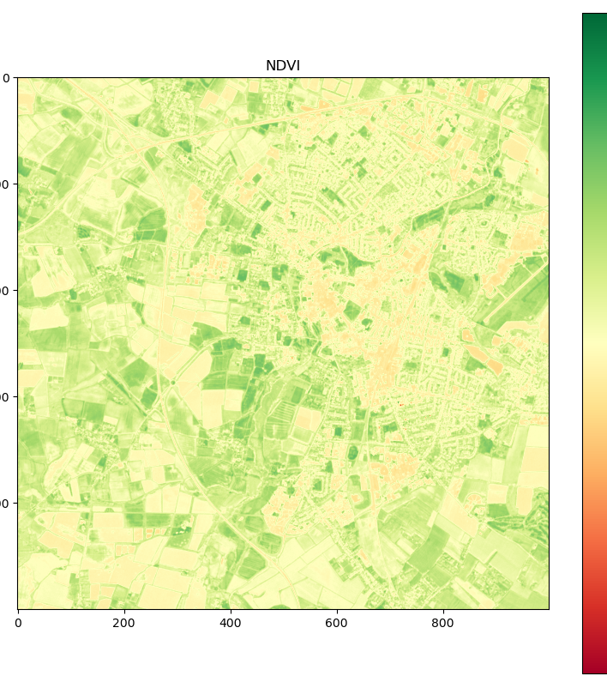
NDVI (Normalized Difference Vegetation Index)
Measures vegetation health and density
Formula: NDVI = (NIR - RED) / (NIR + RED)
Values range from -1 to +1
Higher values indicate healthier vegetation
Used for site selection and shading analysis

Slide 14
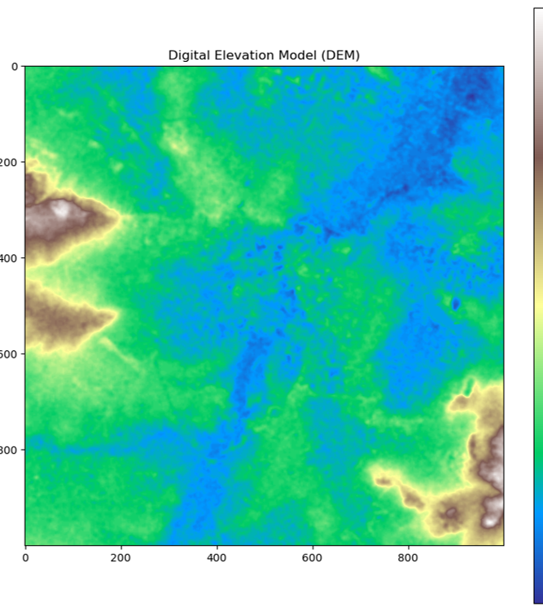
DEM and Slope Analysis
DEM: Grid-based representation of Earth's surface
Important for assessing terrain suitability
Affects solar panel efficiency and installation
Threshold set at 15 degrees for practicality

Slide 15
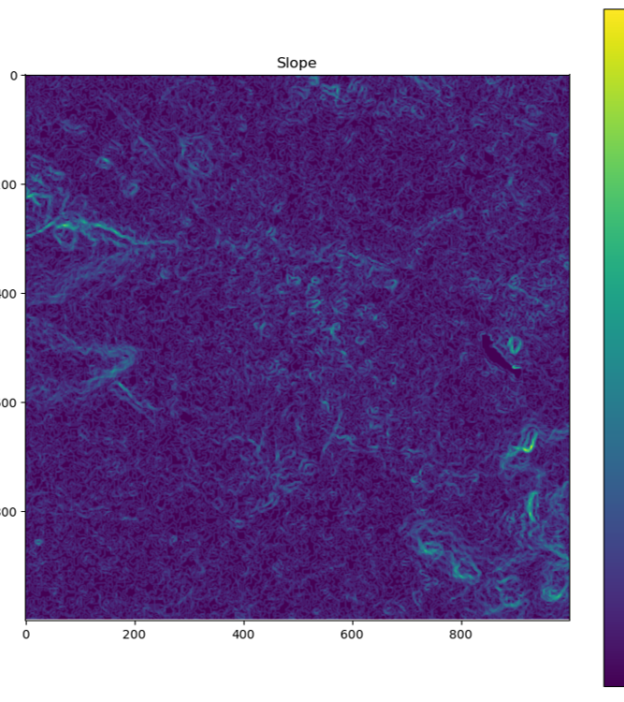
Slope
Calculated from the Digital elevation model image:
Using the formula:
slope = arctan(√[(∂z/∂x) ² + (∂z/∂y) ²])
used to calculate the slope of a surface in 3D space, where the surface is defined by a function z=f(x, y).
This is a common method in geographical information systems (GIS) and terrain analysis to determine the steepness of a landscape.

Slide 16
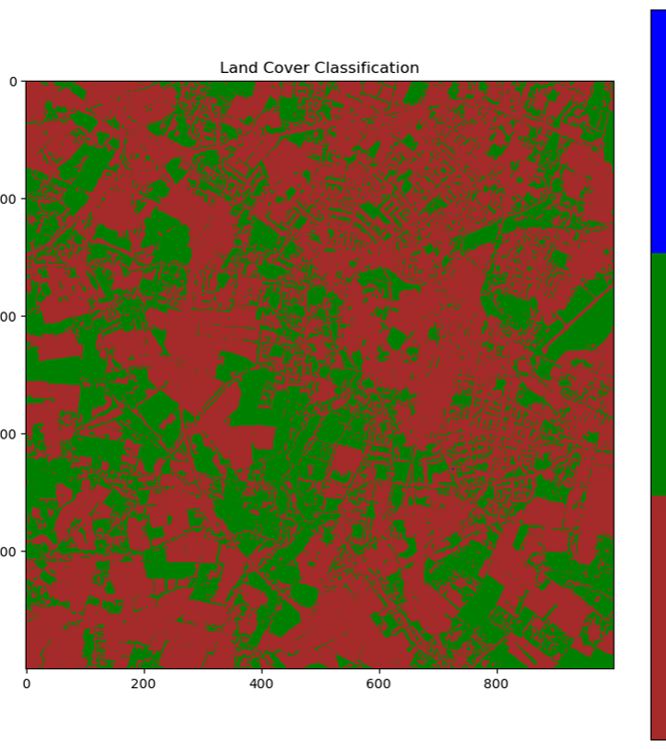
Land Cover Classification
Categorizes land into different types
Uses spectral bands and indices (NDVI, NDBI)
Machine learning techniques applied
Random Forest
Essential for site selection and impact assessment

Slide 17
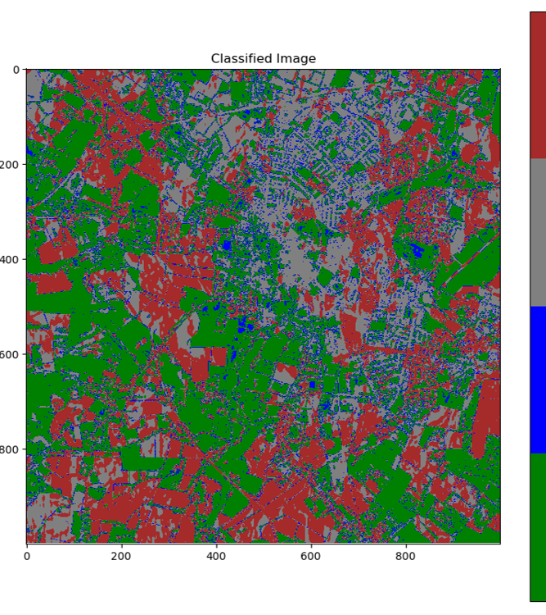
Otsu's Thresholding Method
Unsupervised image segmentation technique
Automatically determines optimal threshold
Applied to NDVI, NDBI, NIR, and SWIR bands
Useful for binary classification problems

Slide 18
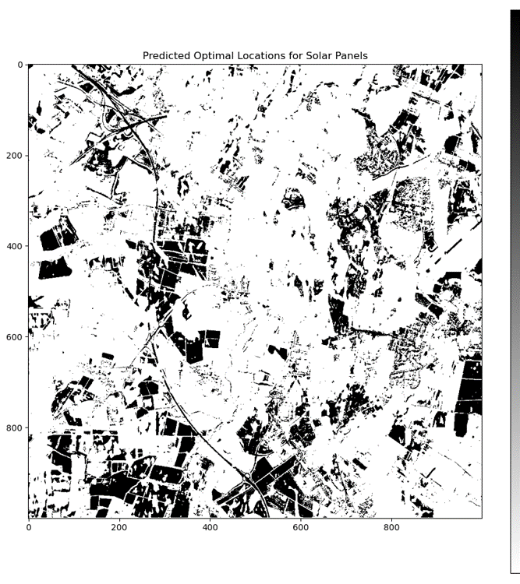
Random Forest Classifier
Train: Classifier on features for suitability
Predict: Suitable locations for solar panels
Visualize: Binary suitability map
Issue: Predefined thresholds limit learning

Slide 19
Improved Approach
Flexible Feature Utilization:
Use raw features instead of strict thresholds to capture more nuanced data patterns.
Enhanced Model Learning:
Enable the model to learn complex relationships between features, improving predictive accuracy.

Slide 20
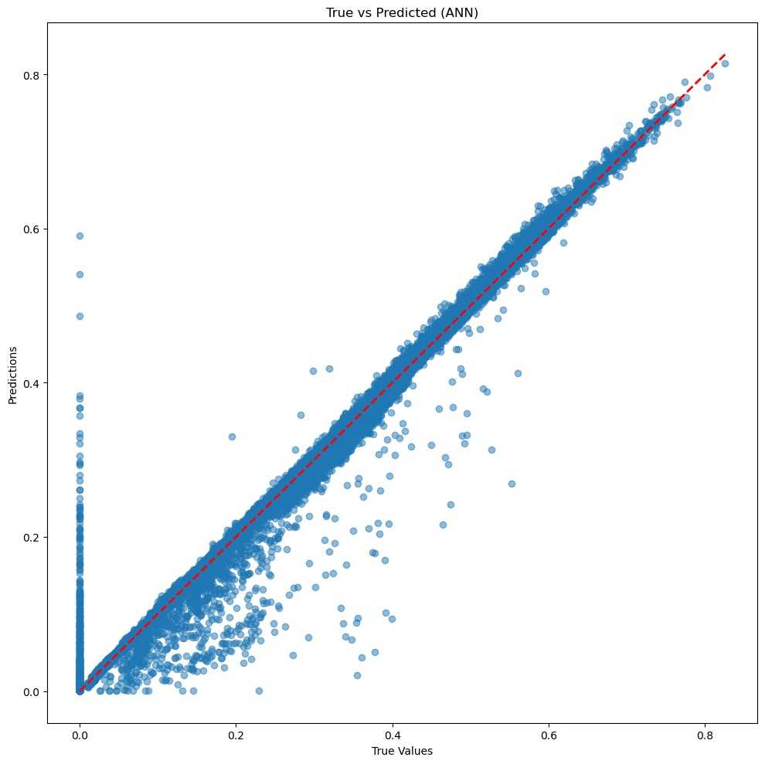
Results
Parameters | Artificial Neural Network (ANN) | Deep Neural Network (DNN) | Random Forest | Gradient Boosting
Mean Squared Error (MSE) | ~ 0.000045 | ~ 0.000059 | ~ 0.000082 | ~ 0.000443
R-squared (R²) | ~ 0.997 | ~ 0.996 | ~ 0.995 | ~ 0.970
Observation | Highest predictive accuracy; closely aligned with actual solar potential | Slightly higher error than ANN, but still highly accurate and reliable | Strong performance, slightly less accurate than ANN and DNN | Effective but with higher prediction errors, particularly in mid-to-high potential areas
ANN – True vs Predicted

Slide 21
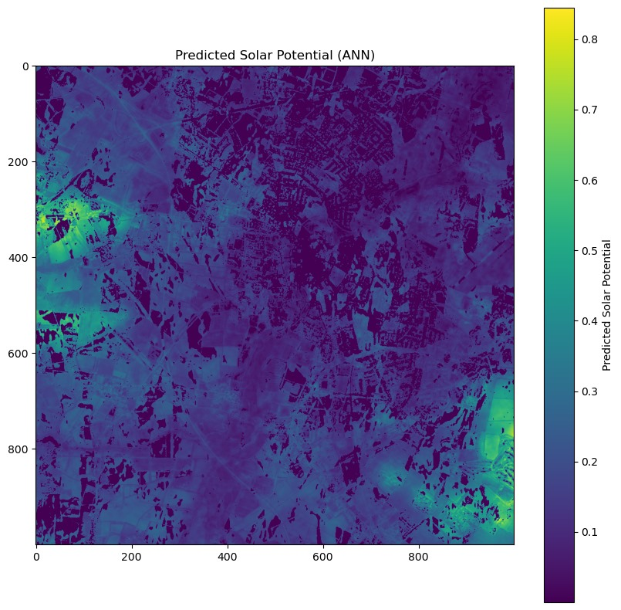
Conclusions And Further Explorations
Key Conclusions:
Most effective: ANN and DNN models for predicting solar potential, offer high accuracy and have minimal error.
Random Forest also shows strong predictive capabilities, suitable for similar applications.
Gradient Boosting is reliable but may require further refinement for optimal use in solar potential mapping.
Implications for Stakeholders:
Investors: Leverage high-accuracy predictions to minimize financial risks and optimize returns in solar energy projects.
Urban Planners & Policymakers: Utilize these models for informed decision-making in renewable energy infrastructure development.
Broader Impact: These models set new benchmarks for accuracy and efficiency, potentially transforming renewable energy site selection and planning.
ANN – Areas with Solar Energy Potential (lighter colour)

